Slide 1


Source Hacking: Media Manipulation in Practice
By Joan Donovan and Brian Friedberg
Harvard Kennedy School
Presented by Shawn M. Jones
Old Dominion University
CS 895: Web Archiving Forensics, Fall 2020

Slide 2
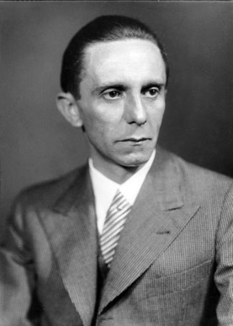
“If you tell a lie big enough and keep repeating it, people will eventually come to believe it.” – Nazi Politician Joseph Goebbels

Slide 3
“If you tell a lie big enough and keep repeating it, people will eventually come to believe it.” – Nazi Politician Joseph Goebbels
According to Randall Bytwerk of the Calvin University German Propaganda Archive, Goebbels never said this.
Ref: https://www.bytwerk.com/gpa/falsenaziquotations.htm

Slide 4
What is Source Hacking?
“a set of techniques for hiding the sources of problematic information in order to permit its circulation in mainstream media”

Slide 5



Conspiracy theorists are not good conduits for spreading disinformation
The general public is suspicious of conspiracy theorists
disinformation
information manipulator
Conspiracy theorists

Slide 6

Source Hacking is an indirect method of targeting journalists
The general public is suspicious of conspiracy theorists
disinformation
information manipulator
Conspiracy theorists
Because certain journalists have an audience and trust from some members of the public, eventually the story is circulated by the general public
The information manipulator places the disinformation in places that journalists, or intermediaries, are likely to encounter it
Journalist with an audience

Slide 7
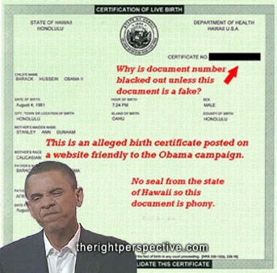
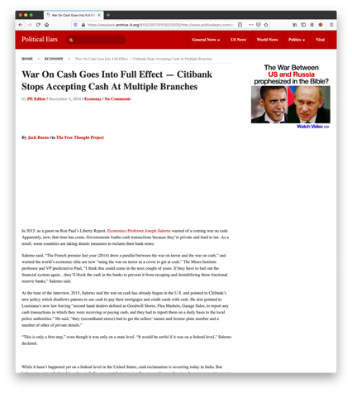
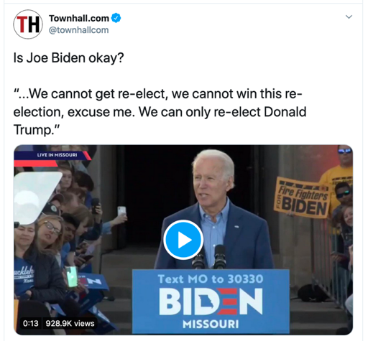
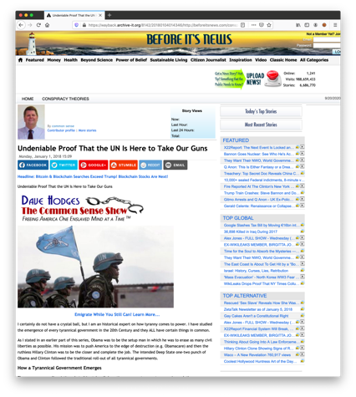
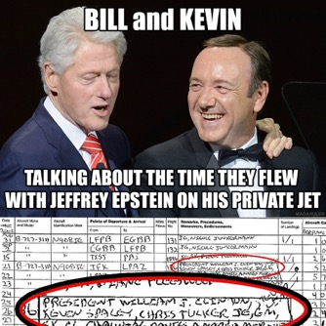
Information manipulators create persuasive audiovisual materials, merging techniques of marketing and political propaganda
Persuasive memes
Convincing fake articles
Heavily edited video

Slide 8
Information manipulators employ Data Craft
“a set of practices that create, rely, or even play with the proliferation of data on social media by engaging with new computational and algorithmic mechanisms of organization and classification”
– Amelia Acker (2018)
Amelia Acker, “Data Craft” (Data & Society Research Institute, November 5, 2018), https://datasociety.net/output/data-craft/.

Slide 9
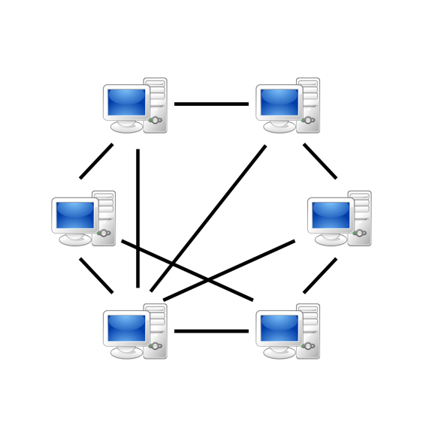
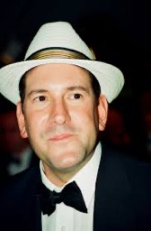
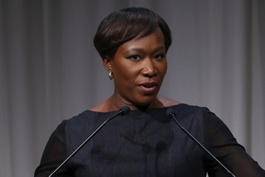
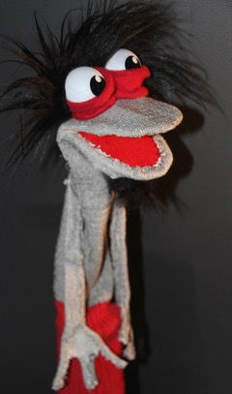
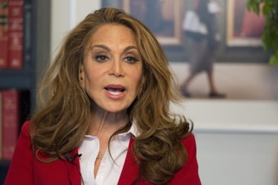

Information manipulators spread their message by influencing trending content and saturating hashtags
Sockpuppet accounts
Botnets
Social media influencers
Legitimizing the message through metrics:
e.g., more likes, retweets, original posts
Legitimizing the message through endorsement or denial
Bandwagon effect
Testimonials

Slide 10
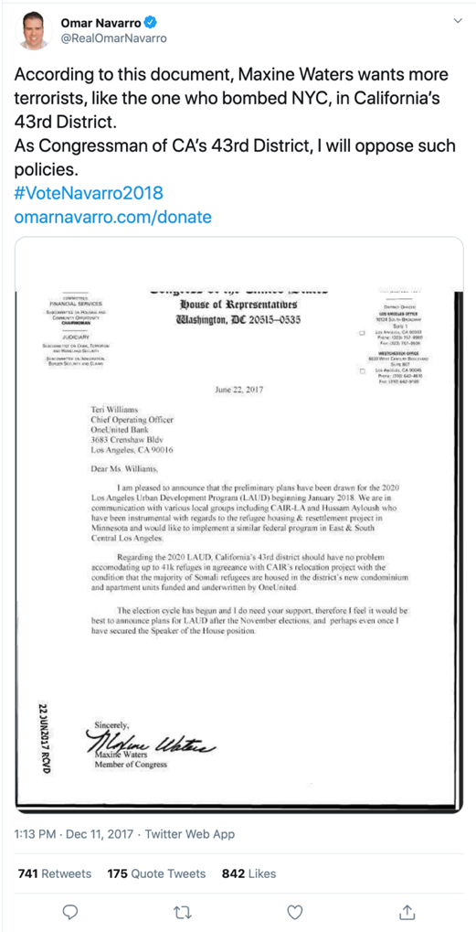
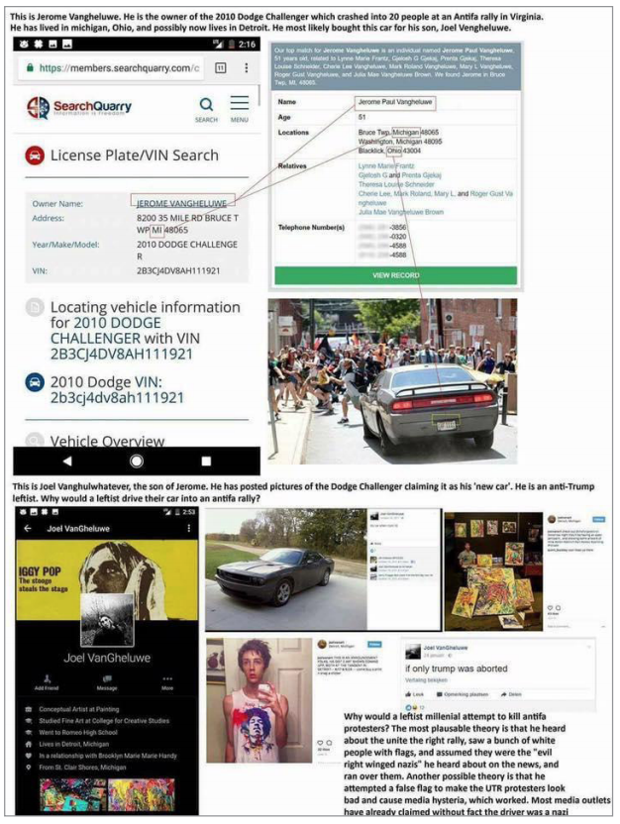
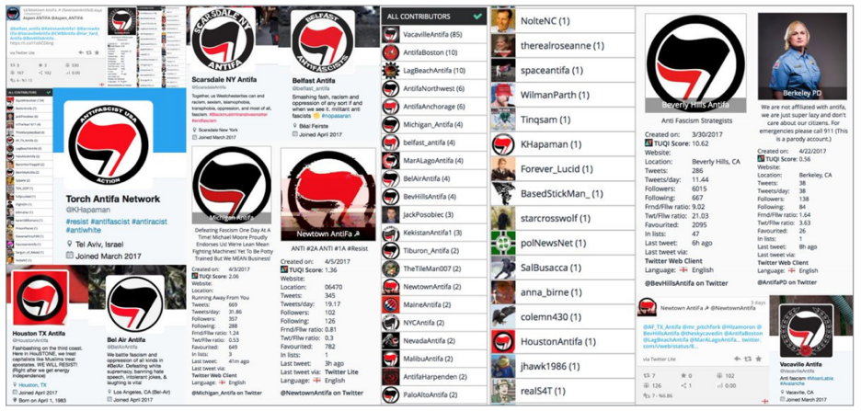
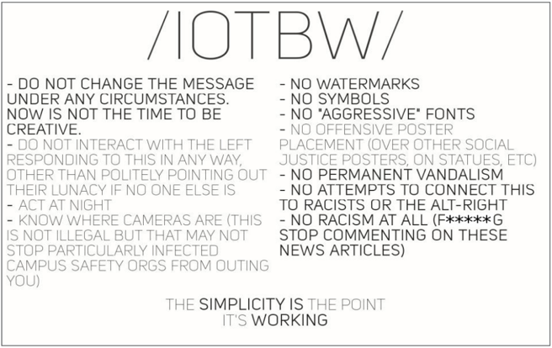
We will cover case studies of four source hacking techniques
Viral Sloganeering
“repackaging reactionary talking points for social media and press amplification”
Leak Forgery
“prompting a media spectacle by sharing forged documents”
Evidence Collages
“compiling information from multiple sources into a single, shareable document, usually as an image”
Keyword Squatting
the strategic domination of keywords and sockpuppet accounts to misrepresent groups or individuals

Slide 11
We will cover case studies of four source hacking techniques
Viral Sloganeering
“repackaging reactionary talking points for social media and press amplification”
Leak Forgery
“prompting a media spectacle by sharing forged documents”
Evidence Collages
“compiling information from multiple sources into a single, shareable document, usually as an image”
Keyword Squatting
the strategic domination of keywords and sockpuppet accounts to misrepresent groups or individuals

Slide 12
We will cover case studies of four source hacking techniques
Viral Sloganeering
“repackaging reactionary talking points for social media and press amplification”
Leak Forgery
“prompting a media spectacle by sharing forged documents”
Evidence Collages
“compiling information from multiple sources into a single, shareable document, usually as an image”
Keyword Squatting
the strategic domination of keywords and sockpuppet accounts to misrepresent groups or individuals

Slide 13
We will cover case studies of four source hacking techniques
Viral Sloganeering
“repackaging reactionary talking points for social media and press amplification”
Leak Forgery
“prompting a media spectacle by sharing forged documents”
Evidence Collages
“compiling information from multiple sources into a single, shareable document, usually as an image”
Keyword Squatting
the strategic domination of keywords and sockpuppet accounts to misrepresent groups or individuals

Slide 14
We will cover case studies of four source hacking techniques
Viral Sloganeering
“repackaging reactionary talking points for social media and press amplification”
Leak Forgery
“prompting a media spectacle by sharing forged documents”
Evidence Collages
“compiling information from multiple sources into a single, shareable document, usually as an image”
Keyword Squatting
the strategic domination of keywords and sockpuppet accounts to misrepresent groups or individuals

Slide 15
Viral Sloganeering
a process of crafting divisive cultural or political messages in the form of short slogans and propagating these (both online and offline) in an effort to inﬂuence viewers, force media coverage, and provoke institutional responses

Slide 16
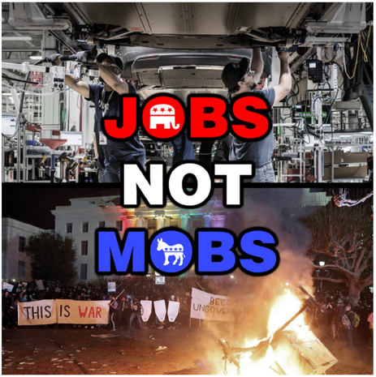
Viral Sloganeering
co-opt an existing controversy or news topic
fill “data voids” – combinations of terms or search queries with little existing content that can be easily associated with political messaging
spread:
memes
hashtags
posters
videos
easily transmitted and copied
if the manipulator successfully hides the origin of the meme, mainstream media sources may amplify it further

Slide 17



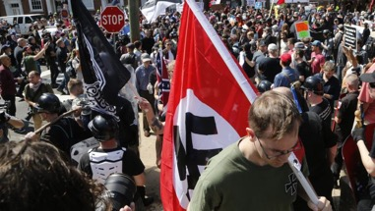



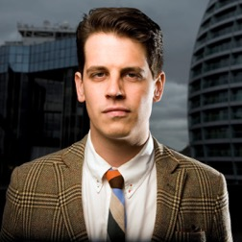


Subjects in “It’s OK To Be White” viral slogan
The Washington Post
Mainstream Media
News Organization
Stormfront
white nationalist, antisemitic, Holocaust-denialist, neo-Nazi web site
4chan
Social Media
Organization
The Boston Globe
Mainstream Media
News Organization
Black Lives Matter
Racial Injustice/Police Reform Movement
White Supremacists
(target)
Discord
Social Media
Organization
The Daily Caller
Right-Wing Media
News Organization
Fox News
Conservative Media
News Organization
Milo Yiannoploulos
Right-Wing
Social Media Influencer
College Campuses
YouTube
Social Media
Organization
Tucker Carlson
Fox News Commentator
Australian Parliament
wedge issue: racism

Slide 18
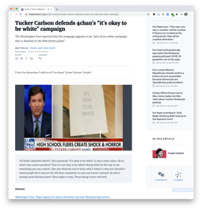
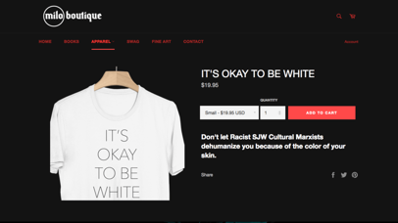
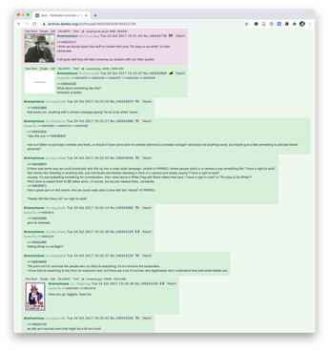
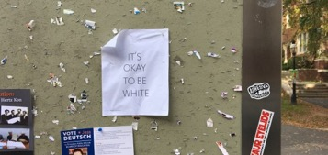
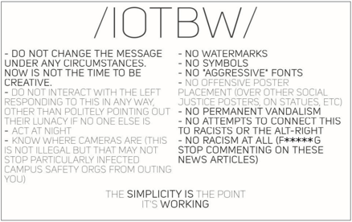
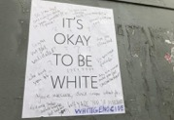
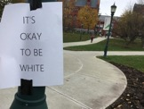
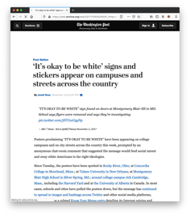
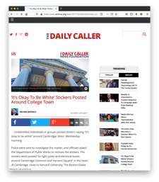
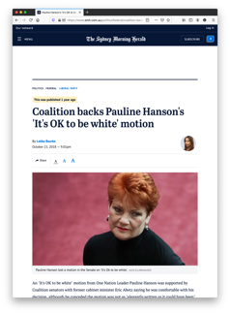
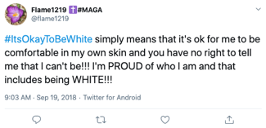
“It’s OK To Be White” viral slogan timeline
Milo Yiannoploulos starts selling “It’s Okay to Be White” T-Shirts during his college campus tour
Fox News Commentator Tucker Carlson accuses the left of sowing racial division by expression offense at the slogan – exactly what the manipulators wanted
4
6
Unknown individuals start posting “It’s Okay To Be White” Posters on college campuses
1
4chan users start discussing the idea of the campaign:
develop a simple white/black flyer
never mention its white supremacist origins or use any white supremacy symbols, fonts, or language
strive to ensure that you are not recorded placing the flyer
distribute these instructions elsewhere online, including Stormfront and Discord
2
5
Media Outlets begin covering the story, linking to the white supremacist 4chan conversation
7
Nationalist Australian Senators put forward a motion to acknowledge ”anti-white racism” – the motion was defeated
3
Hashtags began circulating on social media

Slide 19
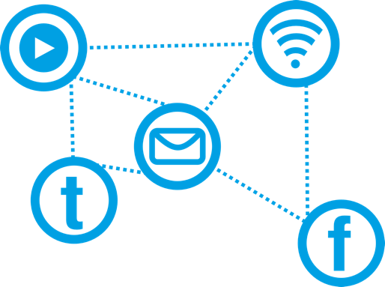
Viral sloganeering: recommendations
platforms:
understand how these slogans rise in attention
analyze their growth to determine if it is organic or operational
journalists
must understand their role in amplifying the message
should be careful calling attention to a slogan that is only popular within a particular community

Slide 20
Leak Forgery
a process of forging documents that are then released by manipulators as apparent leaks from their political targets

Slide 21
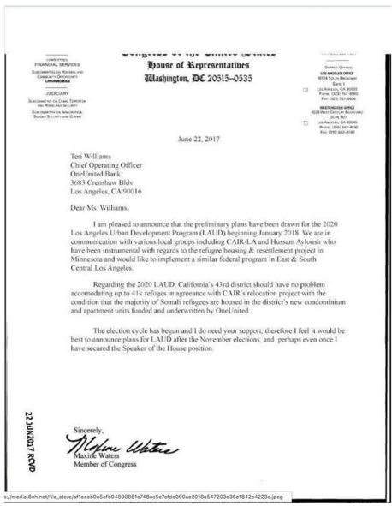
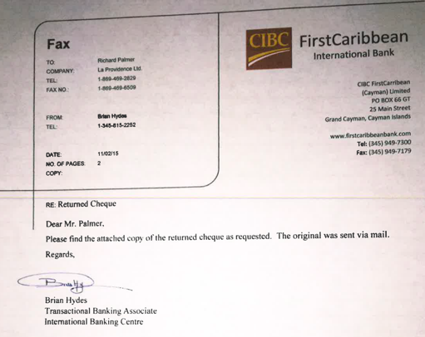
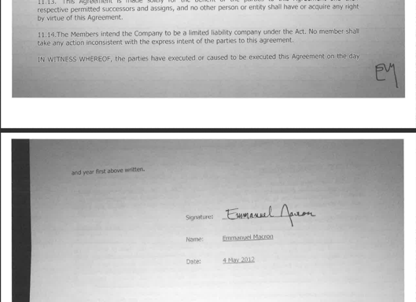
Leak Forgery
leaks gain press exposure by their nature
notable leaks are already an acceptable form of protest in the public interest:
Edward Snowden
Chelsea Manning
WikiLeaks
leaks are often anonymous and thus a good place to insert forged documents
puts the target on the defense – it forces the target to disprove the leak’s claims – increasing news coverage and sowing doubt about the target

Slide 22

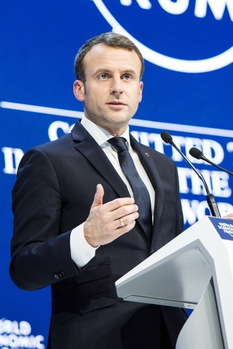



Subjects in the Macron Leak
Jack Posobiec
Alt Right Political Activist and Conspiracy Theorist
WikiLeaks Leak Publishing Organization
Emmanuel Macron
2017 La République En Marche Candidate for the French Presidency
Marie Le Pen
2017 National Rally Candidate
for the French Presidency
4chan
Social Media
Organization
Twitter
Social Media
Organization
(target)
wedge issue: globalization

Slide 23
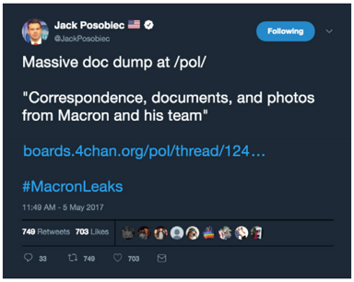
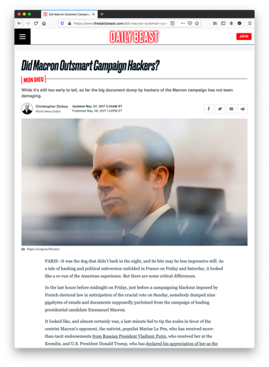
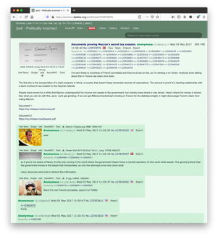
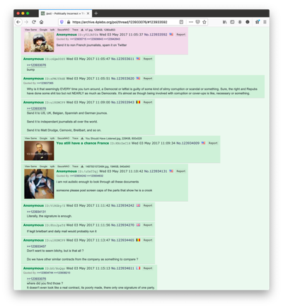
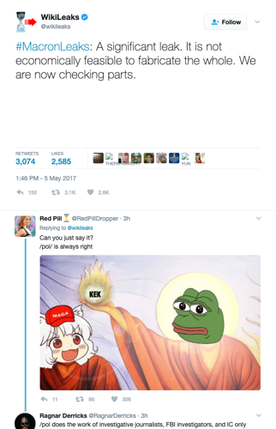

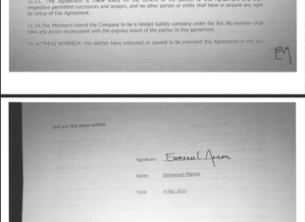
The Macron Leak timeline
Macron’s campaign publicly acknowledges the leak, which is then further covered by other press outlets
More 4chan users, including Wikileaks, spread the leaked documents and encourage distribution to Twitter and elsewhere to sway the vote in favor of Le Pen
Anonymous 4chan user posts Documents proving Macron’s secret tax evasion allegedly collected via a phishing scam
On Twitter, Wikileaks and Jack Posobiec share “leaks” with followers, further extending the conversation
1
2
3
4

Slide 24
Leak forgery: recommendations
journalists & platforms
check the provenance of the leaked documents
this is more difficult when forgeries are mixed with legitimate leaked documents
note when there is a clear wedge issue at play
journalists
coordinate fact-checking efforts

Slide 25
Evidence Collages
image ﬁles featuring a series of screenshots and text that arrange evidence of a particular event or activity

Slide 26

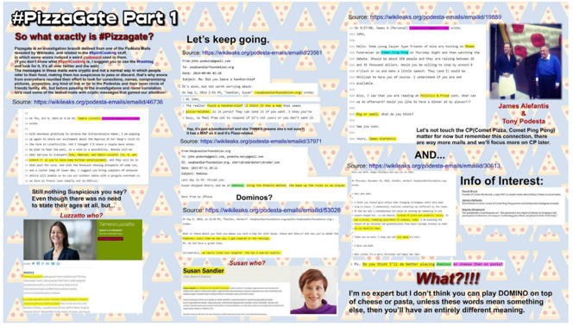
Evidence Collages
users are already familiar with infographics
evidence collages’ purpose is to encourage citizens to conduct their own investigations
consist of verified and unverified information
easy to share because it is a single image
the presentation complicates the ability for a user to conduct their own search
may contain URLs to more information supporting the “evidence”
police and journalists rely on social media for information, helping reinforce that users are viable sources
everyday users participated in tracking down suspects in the Boston Marathon Bombing, emboldening some to believe that they can “crack the case”

Slide 27
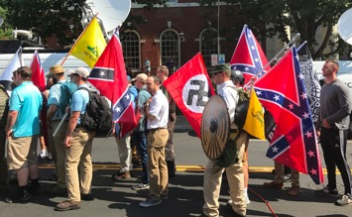
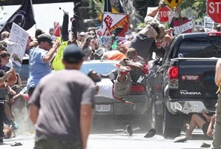
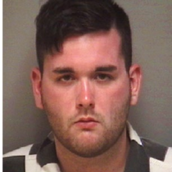
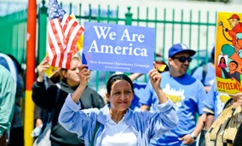

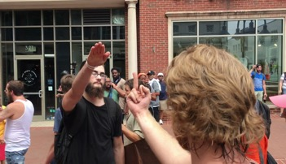



Subjects in the evidence collage for the Charlottesville Unite the Right Rally
4chan
Social Media
Organization
Puppet String News
Right-wing News Source
Unite the Right Rally
Participants
Charlottesville car attack
(event)
Left-leaning
activists
James Fields
actual hit-and-run
perpetrator
(target)
Twitter
Social Media
Organization
The Gateway Pundit
Right-wing News Source
Counter-protesters
Heather Heyer and 35 others
counter-protester
victims
Millenials
Reddit
Social Media
Organization
Joel VanGheluwe
accused of car attack in evidence collage
ZeroHedge
Right-wing Blog
(target)
Free Republic
Right-wing Social Media Organization
(target)
wedge issue: violence among political groups

Slide 28
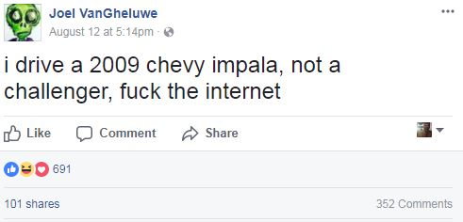
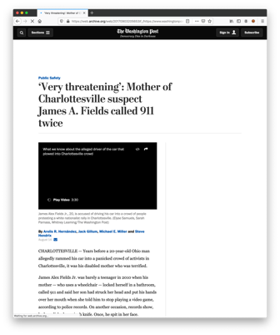
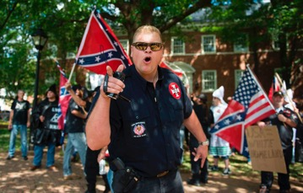
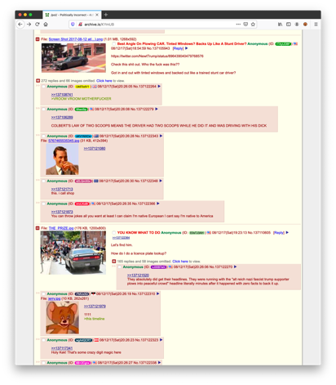






Charlottesville Unite the Right Rally evidence collage timeline
Joel VanGheluwe is then harassed and must flee his home with his family to hide
3
Unite the Right Rally on August 12, 2017 leads to counter-protests, and someone drives a car into counter-protesters, killing 1 and injuring 35
On 4chan/pol someone posts an evidence collage identifying the driver as left-leaning student Joel VanGheluwe based on the license plate record of the car – this collage spreads to Reddit, ZeroHedge, and other social media
5
August 19, 2017
alt-right supporter and Ohioan James Fields is charged by police as the actual perpetrator
1
2
4
Puppet String News, Gateway Pundit, and GotNews share the evidence collage

Slide 29
Problems with the data craft in this evidence collage
Screenshots from the same smartphone, based on battery life, clock, and open apps, indicate the same actor created this collage.

Slide 30
Evidence collages: recommendations
Journalists & Platforms
seek out signs of cross-platform coordination
be wary of image files that circulate without clear authorship
use reverse image software to look for the collage on other sites
search for timestamps and other metadata to determine if it came from a single individual or group
do not recirculate if the identity of an individual is released
moderate comments to articles and social media posts to prevent legitimate sources from hosting this disinformation
Platforms
assist account holders with controlling content and comments on their pages

Slide 31
Keyword Squatting
a technique of creating social media accounts or content associated with speciﬁc terms to capture and control future search traffic

Slide 32


Keyword Squatting
associates content with certain keywords, including hashtags, to ensure that only the desired perspective shows up in search results
use sockpuppet social media accounts to impersonate a specific individual, group, or movement
if possible, pre-emptively claim usernames and hashtags before legitimate groups
the amount of disinformation must exceed the amount of legitimate content for this to be successful
apply botnets to ensure that this is done at scale

Slide 33







Subjects in Antifa social media accounts keyword squatting
Investigative Journalism Fact-Checking Website
Twitter
Social Media
Organization
Fox News
Right-leaning
News Organization
Antifa
(not well organized)
Female Donald Trump Supporters
(target)
Facebook
Social Media
Organization
Jesse Waters
Fox News Commentator
Elliot Higgins
Bellingcat
Investigative Journalist
Kevin Stafford
“BG Kumbi”
Antifa
(Internet Troll,
Not Really Antifa)
4chan
Social Media
Organization
White Supremacists
(better organized)
The New York Times
Mainstream Media Organization
wedge issue: support of Trump

Slide 34




Antifa social media accounts timeline
Because there is no core Antifa organization, far right individuals create fake antifa accounts on social media to provide a presence that supports existing fears about Antifa organizations and their members
# of fake Antifa accounts
> # of real Antifa accounts
One of these accounts received coverage in the New York Times, legitimizing the account as representing Antifa
Because of his YouTube account, “Antifa” member Kevin Stafford is invited to speak on Fox News, further perpetuating fears about Antifa via a mainstream media outlet
Elliot Higgins from Bellingcat discovered the fake Antifa accounts when they began using the hashtag #PunchANazi as a call for violence against female Trump supporters
1
2
3
4

Slide 35
Keyword squatting: recommendations
Platforms
use the metadata of accounts to analyze the origins of memes and slogans – especially those used in advertisements
assess if the information circulated is coherent with its source organization
raise the alarm on accounts that solicit donations to unidentified entities
make more account metadata accessible on the “about” or “bio” pages of accounts
Facebook and Twitter have already begun some of this

Slide 36
Summary

Slide 37



Review
viral sloganeering allows small groups to receive disproportionate media coverage
forged leaks exist to defame public figures
evidence collages amplify propaganda to sway media coverage
keyword squatting allows manipulators to shake the impression of targeted groups
multiple source hacking techniques are often used together
small groups use these techniques to polarize conversation through wedge issues
to be successful, these techniques often require partisan buy-in

Slide 38







Manipulation campaigns are a feature of contemporary social media
public relations companies
scammers
&
grifters
hackers
advertisers
trolls
politicians
other
users
spies
social media user

Slide 39
We can combat source hacking
greater attention to coordination across platforms is the most productive way to guard against these methods
attention to data craft allows us to debunk these items
we must continue to study these tactics or they will continue to evolve
avoid terms like “trending” or “trolling” because they are imprecise
evidence collages and leaks should be treated with utmost suspicion
be aware, however, that manipulators know they are being watched and may engineer the researcher as well

Slide 40

Social media has vulnerabilities
social media has united people toward common causes
it has produced positive change in societies
there are many cracks in the wall of social media, and we need stronger supports:
culturally
technologically
legally
media manipulators are taking advantage of these weaknesses to fight information wars

Slide 41
Backup Slides

Slide 42



Information manipulators use data craft to successfully work around existing protection systems
Spam detection
Platforms’ terms of service
Platforms’ Trust and Safety Teams

Slide 43






Subjects in “Jobs Not Mobs” viral slogan
Twitter
Social Media
Organization
Nationalists
Facebook
Social Media
Organization
refugees
Anti-fascists
(target)
(target)
Fox News
Conservative Media
News Organization
Right-wing
pundits
Reddit
Social Media
Organization
Left-leaning
activists
immigrants
(target)
(target)
YouTube
Social Media
Organization
wedge issue: immigration
Donald Trump

Slide 44





“Jobs Not Mobs” viral slogan timeline
Donald Trump begins using the slogan
5
Someone creates decontextualized YouTube video clips of “mobs” and users spread it on Twitter
Redditor BryanVision created the meme
Fox News and right-wing pundits use the term “mobs” to refer to political opponents, refugees, and immigrants
Twitter user @hawgheaven responds to a video of Trump with #JobsNotMobs
4
With Trump using the slogan, other media outlets begin referring to it
3
1
2
6
https://www.nytimes.com/interactive/2018/11/04/technology/jobs-not-mobs.html

Slide 45







Subjects in the Waters Leak
Los Angeles Times
News Organization
8chan
(now 8kun)
Social Media Website
known for white supremacism, neo-Nazisim,
anti-Semitism, alt-right,
child pornography,
mass shootings
Twitter
Social Media
Organization
US Department of Justice
YouTube
Social Media
Organization
Maxine Waters
U.S. Representative for California's 43rd congressional district since 1991
Omar Navarro
Opposition Candidate for U.S. Representative for California's 43rd congressional district
in 2016, 2018, 2020, 2022
Kirk Smith
Donald Trump Supporter
Twitter Handle:
@SavingAmerica4U
(target)
OneUnited Bank
Trust Company
wedge issue: immigration

Slide 46




The Waters Leak timeline
3
1
In February 2018, representative Waters’ posts a tweet denying the document, which draws further attention to it in the press and acknowledges that Waters has an opponent
4
An anonymous 8chan user “leaks” a forged document purporting that Waters will allow 41,000 immigrants to move to her district in exchange for a sizeable campaign donation from OneUnited Bank
Navarro acknowledges Waters’ tweet in a YouTube video for campaign fundraising
2
Omar Navarro tweets it in December 2017

Slide 47












Subjects in the Pizzagate evidence collage
Comet Ping Pong
Restaurant
Washington, DC
John Podesta
Political Consultant
Twitter
Social Media
Organization
4chan
Social Media
Organization
Democratic Party
US Left-center Political Party
(target)
Jeffrey Epstein
Sex Offender
(target)
Edgar Madison Welch
Comet Ping Pong Shooting
Gunman
YouTube
Social Media
Organization
Reddit
Social Media
Organization
“world leaders”
Hillary Clinton
Presidential Candidate
US Democratic Party
(target)
Alex Jones
Right-wing
conspiracy theorist
Rolling Stone
News Magazine
QAnon Conspiracy Theory Supporters
(target)
WikiLeaks Leak Publishing Organization
wedge issue: homophobia/transphobia

Slide 48









Pizzagate evidence collage timeline
More than a decade of sex offense investigations into Jeffrey Epstein
5
Edgar Welch, armed, attacks Comet Ping Pong restaurant to “rescue the children”
1
4
Evidence collages ”connecting the dots” for how leftists who support LGBTQ rights are really discussing raping children spread through social media – including multiple references from emails about the Comet Ping Pong restaurant
3
Using a combination of the Podesta emails and amateur investigations into Epstein, far-right pundits tweet that they have “cracked the code” on how leftist references to food are code for child sex trafficking
6
Wikileaks releases emails from political consultant John Podesta
2
It is adopted by QAnon who continues to spread it

Slide 49

A PizzaGate evidence collage
Under each Wikleaks email URL is a block of text connecting it out of context to other emails from the Podesta leak.
Eventually, it links to James Alefantis, owner of Comet Ping Pong.

Slide 50






Subjects in the Internet Research Agency’s keyword squatting
Twitter
Social Media
Organization
CNN
News Organization
Агентство интернет-исследований (Internet Research Agency)
Yevgeny Prigozhin
Owner of IRA
Vladmir Putin Associate
Instagram
Social Media
Organization
Black Lives Matter
Racial Injustice/Police Reform Movement
Racial Injustice Activists
LGBTQ Activists
Tow Center for Digital Journalism
Facebook
Social Media
Organization
(target)
(target)
(target)
(many others)
wedge issue: racism/police brutality
(target)

Slide 51





Internet Research Agency keyword squatting timeline
IRA targets black Americans, but also creates fake black activist groups, like Black Matters and Blacktivist, that could be mistaken for Black Lives Matter
These accounts had a presence on other platforms, like Instagram and Twitter
In 2017, with 470 Facebook accounts, the Internet Research Agency creates 3,000 ads around many wedge issues
CNN and other outlets break the stories about the fake accounts and Tow releases a dataset of them for study
1
2
3
Facebook Ads photo sources: https://money.cnn.com/2017/11/01/media/russian-facebook-ads-release-house-intelligence-committee/index.html https://www.nytimes.com/2018/12/17/us/russian-social-media-posts.html
4

